Slide 1
Meeting and Exceeding Local Control Funding Formula Public Engagement Requirements
ILG Webinar
October 7, 2014 10:00am – 11:00am

Slide 2
Speakers Alisa MacAvoy, Trustee, Redwood City School District and President, San Mateo County School Boards Association Peter Wright, Policy and Programs Officer, California School Boards Association Moderator Sarah Rubin, Program Manager, Public Engagement Program, Institute for Local Government

Slide 3
ILG Mission
Promoting good government at the local level
Practical, impartial and easy-to-use materials
Notes:
The Institute for Local Government promotes good government at the local level with practical, impartial and easy-to-use resources for California communities. ILG’s resources are in many areas including ethics, collaboration, public engagement and sustainable communities. ILG is the research and education affiliate of the California State Association of Counties and the League of California Cities.

Slide 5
Polling Question

Slide 6
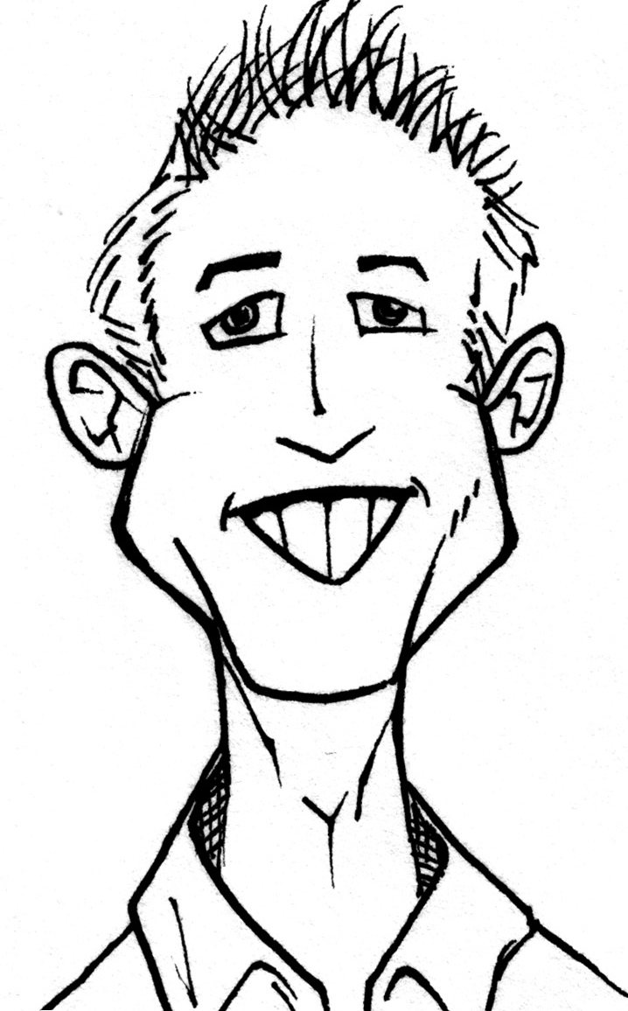
What is LCFF? What is Public Engagement?
Peter Wright Policy and Programs Officer
(805) 452-1075
pwright@csba.org

Slide 7
Game Plan
Quick review of LCFF public engagement requirements
How can these requirements promote good governance
The challenges of public engagement
Strategies for great public engagement

Slide 8
Paradigm Shift
Equity for children from low-income families, English learners, and foster youth
Local decision making and stakeholder engagement
Transparency and accountability
Alignment of goals with budgets

Slide 9
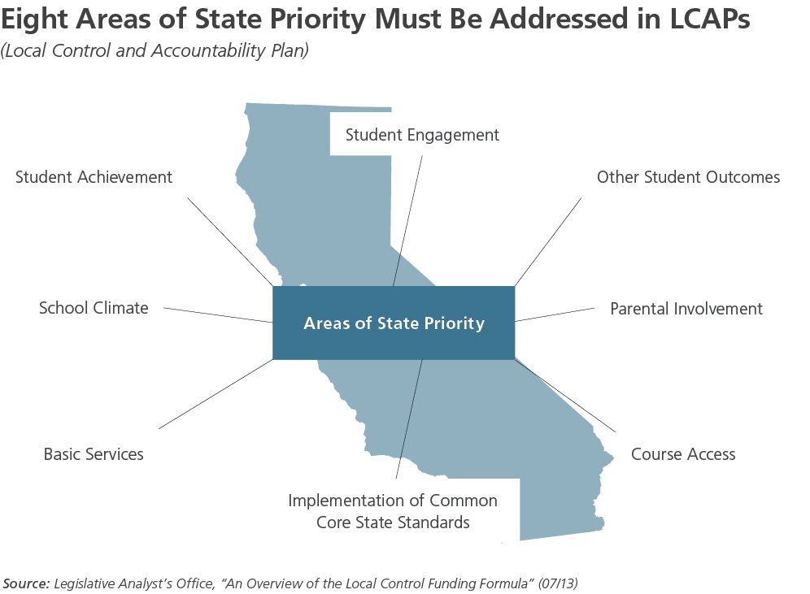
Local Control & Accountability Plans
Notes:
LCAPs are 3-year plans that are reviewed for progress and updated each year. LEAs may add local priorities to their plans.
Plans must be aligned to LEA’s budget and describe:
Annual goals for all pupils and each subgroup to be achieved for each of the state priorities identified in statute and any additional local priorities identify bye the local governing board.
Specific actions the LEA will take during each year to achieve those goals.
LEAs must conduct annual updates and review of progress in meeting goals.
Governing boards are required to consult with teachers, principals, administrators, other school personnel, parents and pupils in developing an LCAP. Districts must also provide parent and EL parent advisory groups opportunities to advise on development of LCAPs.

Slide 10
Public Engagement
Parents and students are the producers, not just the consumers.

Slide 11
Public Engagement
Districts must:
Consult with teachers, principals, administrators, other school personnel, parents and pupils in developing the LCAP
Establish Parent Advisory Committee to provide advice to board and superintendent on LCAP requirements
Establish an English Learner Parent Advisory Committee if district English learner enrollment is at least 15% and 50 pupils

Slide 12
What does the law say schools must do.
Legal Requirements: State and Federal Law, CA Ed Code, NCLB, etc.
What does the community want its school to do.
The community: its values, priorities, concerns and interests.
The services we provide to students
District Resources: Human, financial, and material assets.
What does the district have the capacity to do.
Professional Research & Literature
What does the profession say the schools ought to do.
Notes:
CSBA first developed this framework in 2007-2008, and it helps board and their communities understand the roles of the board. And these roles can be in conflict.
You are about to feel this conflict.
The four forces describe four major factors that influence board decision-making.
MUST – Boards are required by law to do certain things. We know a little bit about what the accountability requirements are, but the regulations are still being developed. When we have more information about the MUSTS, then the superintendent and staff will be able to develop recommendations on what we OUGHT to do.
OUGHT – Boards trust the professional staff to recommend actions that are based on research and successful best practice.
CAPACITY – Board are required to balance budgets – and ensure the long term stability of the district. When we have more information about how much money is coming, we will have a better sense of what we have the capacity to do.
MUST – When we have more information about the amount of funding, we will have a better sense of what we have the capacity to do.
WANT - We wanted to start the conversation early with you, so that we have a chance to understand your thoughts, interests and ideas.
Tonight we are focusing on this – what the community wants.
OUGHT -

Slide 13
Deliberation is Hard
Campaigning and governing are different

Slide 14
Deliberative vs. Participatory Democracy
Can we have harmony and vibrant debate?

Slide 15
Transparency
Before adopting the LCAP the Governing Board shall:
Hold at least one public hearing to solicit recommendations and comments from the public regarding the specific actions and expenditures in the LCAP.

Slide 16
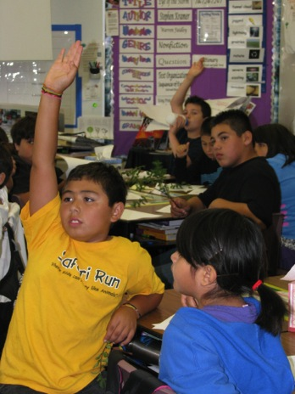
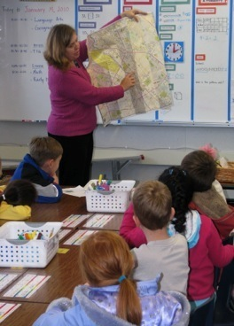
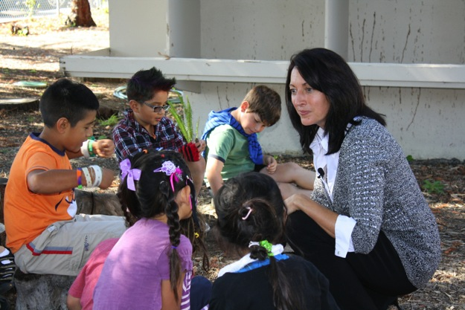
Redwood City: A Case Study
Alisa MacAvoy

Slide 17
LCAP Process in RCSD
LCAP Action | Timing
School Board Work Session | October
Community and school-based Information meetings | November-December
LCAP Community Input Meetings | January
LCAP Staff Input Meetings | January-February
Parent, Student, Staff Survey | January
LCAP Draft, with Advisory Group and Staff | February - April
LCAP Review | May-June
LCAP Board Hearing | Mid-June
LCAP Adopted | End of June
Notes:
District has community schools and traditionally has always done a lot of parent and community engagement
Board member and Principal met with parents, community members and staff at each of our 16 school sites to talk about LCFF and what was coming forth, started to gather priorities, solicited members for the Advisory Committee
Some meetings in just English or Spanish and some with both Languages
Parent/Community meetings at different times and locations to gather more input
Met with DELAC and ELAC groups and our Special Education PTA group
Surveys – paper and web-based of parents, staff, community members
Met with bargaining groups – although smaller group than hoped for…offered multiple opportunities
Finalized Advisory Committee
Heard from local ACLU

Slide 18
Community Presentations
In first meetings, reviewed the LCFF and LCAP
Gathered input on priorities and new program ideas
Solicited parents, staff and community members for the LCAP Advisory Group
Next round of meetings and surveys, concentrated on gathering input on priorities/programs
See next slides for examples

Slide 19
Reason for Meeting
About RCSD
What is the Local Control Funding Formula (LCFF)?
What does LCFF mean for RCSD?
What is the Local Control Accountability Plan (LCAP)
What are the next steps for RCSD?
Notes:
We will explain what the Local Control Funding Formula is.
We will talk about what it means for our school and the school district.
We will explain the Local Control Accountability Plan (LCAP) and how you can get involved in providing input in coming months.
We will explain the steps that will occur between now and when our school district budget is adopted by the board in June 2014.

Slide 20
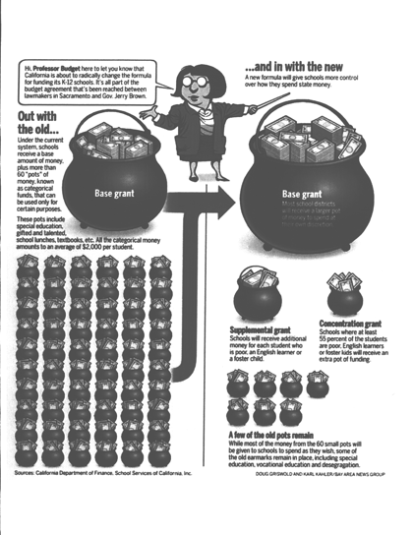
What does LCFF mean for RCSD?
Changes how we receive and spend money
Big transition
Opportunity to define values and spending priorities
Still not adequate funding and well below the national average in per pupil spending
Notes:
This chart was created by School Services, and was recently used in a Mercury News article. It is one of the best illustrations of the old system compared to the new system.
Under the old system, school districts received a base amount of money, plus many small pots of money, called categorical funds. Each of these pots was designated for a specific purpose and could only be used for that purpose. These pots included things like special education, gifted and talented, school lunches, textbooks, etc.
Under LCFF, all the small pots are combined. Now, districts receive a base grant, plus several possible additional grants:
--Supplemental grant ($ for each EL, SED and foster student)
--Concentration grant (extra $ for districts where at least 55 percent of the students are poor, EL or foster kids.)
--A few of the old pots remain: after school, special ed, etc.

Slide 21
What we heard from community
Smaller class sizes
More enrichment, including PE
Transportation, especially on rainy days
After school tutoring
Better food for lunch and breakfast
More after school and summer programs

Slide 22
What we heard from Staff
Salary increases
Benefit increases
Smaller class sizes
More prep time, including collaboration time with peers
More support in the classroom

Slide 23
LCFF/LCAP Advisory Group
Comprised of staff/teacher reps from each school, principals, parents, union reps, district staff, and community members
Reviewed district data
Develop SMART goals, aligned with Board goals
Identified data and metrics to measure progress
Selected highest priority strategies to attain goals for input into LCAP development
Notes:
Data included Gardner Survey (parent data), Assessment data (CST, API and local assessments), LEA Plan, Staff data, Safety Plans, Suspension Data, Expulsion Data, Attendance data

Slide 24
LCAP Process in RCSD Timeline revisited
LCAP Action | Timing
School Board Work Session | October
Community and school-based Information meetings | November-December
LCAP Community Input Meetings | January
LCAP Staff Input Meetings | January-February
Parent, Student, Staff Survey | January
LCAP Drafting, with Advisory Group and Staff | February - April
LCAP Review | May-June
LCAP Board Hearing | Mid-June
LCAP Adopted | End of June
Notes:
District has community schools and traditionally has always done a lot of parent and community engagement
Board member and Principal met with parents, community members and staff at each of our 16 school sites to talk about LCFF and what was coming forth, started to gather priorities, solicited members for the Advisory Committee
Some meetings in just English or Spanish and some with both Languages
Parent/Community meetings at different times and locations to gather more input
Met with DELAC and ELAC groups and our Special Education PTA group
Surveys – paper and web-based of parents, staff, community members
Met with bargaining groups – although smaller group than hoped for…offered multiple opportunities
Finalized Advisory Committee
Heard from local ACLU

Slide 25
Highlights of best practices

Slide 26
Go Where the People Are

Slide 27
Make Your LCAP Accessible

Slide 28
Fun Reading

Slide 29
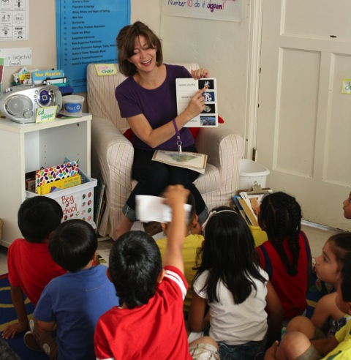
Reflections and Future Planning
Notes:
Despite all of our challenges, the Redwood City School District is a very special school district.
We have amazing staff who have persevered through the financial hardships of the last few years, and have never stopped giving their all to students.
We have continued to make academic gains, even with the cutbacks.
One parent compared us to the “little engine that could” – we always do the best we can with the resources available to us.

Slide 30
Lessons Learned
You can never over communicate
Offer various opportunities to engage – try new things
Include key stakeholders during engagement and on the advisory committee
Expand LCAP to encompass full vision, goals, programs, metrics in the district and don’t just focus on the supplemental and concentration money

Slide 31
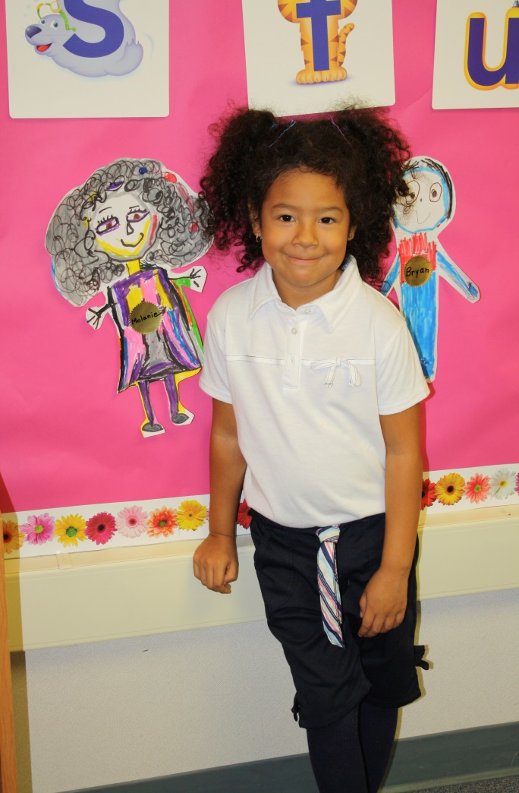
Final Lesson Keep Your Focus on Students
Notes:
In discussions with staff, parents, community members, try where possible to keep the focus on what is best for the students
Be mindful of the groups – Low Income, English Learners, Foster Youth and how to help them and make sure that the supplemental and concentration are spent appropriately to help these students

Slide 32
Polling Question

Slide 33
Questions & Answers

Slide 34
Thank You!
The webinar recording and PowerPoint slides will be available
on ILG’s website shortly.
If you have additional questions please contact Melissa at mkuehne@ca-ilg.org

